Slide 1
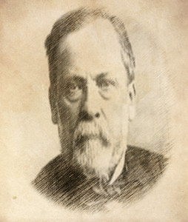
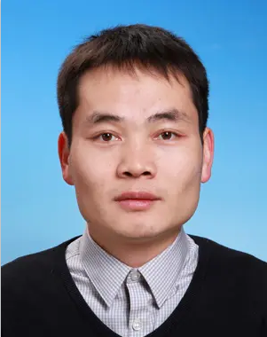
巴斯德讲坛-精英讲坛系列 Pasteur Elite
Study on subcellular structure and behavior by single molecule detection and super-resolution photoelectric fusion imaging
单分子检测和超分辨光电融合成像技术对亚细胞结构和行为的研究
Dr, Wei JI
Professor，Institute of Biophysics, Chinese Academy of Sciences
研究员，中国科学院生物物理研究所
The laboratory of Wei JI focused on developing new technologies that break through the resolution of microscopic imaging, and has made a number of technical and application achievements in the fields of interference single molecule imaging, low temperature single molecule imaging and photoelectric fusion imaging.
纪伟教授致长期致力于发展超高分辨显微成像新型技术，在干涉单分子成像、低温单分子成像、光电融合成像领域取得多项技术及应用成果。
B207, Life Science Research Building
10:00 AM - 11:30 AM
August 12th, 2021
Host: Yaming JIU
腾讯会议直播间 (Tencent Meeting teleconference room)：368 748 234
The Center for Microbes, Development and Health
微生物、发育与健康研究中心

